Slide 1
Intro to Deep Learning for the Absolute Beginner Lecture 4
Esteban (EJ) Guillen
https://github.com/EstebanGuillen/DeepLearningClass
Notes:
Hello and welcome to this course on Deep Learning

Slide 2
Outline
Review Lecture 1-3
Neural Style Transfer
Sequence Models/Recurrent Neural Networks
Word Embeddings
Natural Language Processing

Slide 3
Lesson 14 - Neural style transfer
Content
Style
Content
Style
Generated image
Generated image
[Images generated by Justin Johnson]
Notes:
We want the image on the left to be generated in the style of the image on the right
C – Content Image
S – Style Image
G – Generated Image
Need to look at the feature at various layers of the convolutional neural network

Slide 4
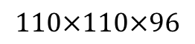
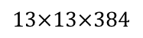
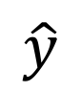
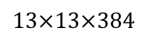
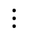
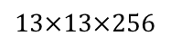
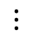
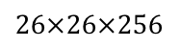
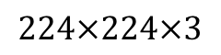
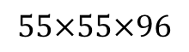
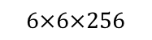
Lession 14 - Visualizing what a CNN is learning
Note: 3 by 3 max pool with stride 2:
$$\hat{y}$$
$$⋮$$
$$⋮$$
$$26×26×256$$
$$13×13×256$$
$$13×13×384$$
$$13×13×384$$
$$6×6×256$$
$$55×55×96$$
FC
4096
FC
4096
$$224×224×3$$
$$110×110×96$$
Pick a unit in layer 1. Find the nine image patches that maximize the unit’s activation.
Repeat for other units.
[Zeiler and Fergus., 2013, Visualizing and understanding convolutional networks]

Slide 5
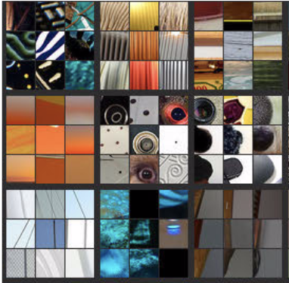
Lesson 14 - Visualizing deep layers
Layer 1
Layer 2
Layer 3
Layer 4
Layer 5
Notes:
Later layers see a larger part of the image
9 patches of the image that cause a neuron to activate

Slide 6
Lesson 14 - Visualizing deep layers: Layer 1
Layer 1
Layer 2
Layer 3
Layer 4
Layer 5

Slide 7
Lesson 14 - Visualizing deep layers: Layer 2
Layer 1
Layer 2
Layer 3
Layer 4
Layer 5

Slide 8
Lesson 14 - Visualizing deep layers: Layer 3
Layer 1
Layer 2
Layer 3
Layer 4
Layer 5

Slide 9
Lesson 14 - Visualizing deep layers: Layer 3
Layer 1
Layer 2
Layer 3
Layer 4
Layer 5

Slide 10
Lesson 14 - Visualizing deep layers: Layer 4
Layer 1
Layer 2
Layer 3
Layer 4
Layer 5

Slide 11
Lesson 14 - Visualizing deep layers: Layer 5
Layer 1
Layer 2
Layer 3
Layer 4
Layer 5

Slide 12
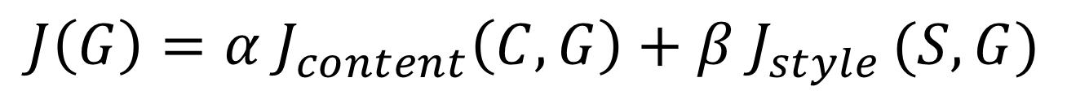
Lesson 14 - Neural style transfer cost function
Content C
Style S
$$J\left(G\right)=α J_{content}\left(C,G\right)+β J_{style }(S,G)$$
Generated image G
[Gatys et al., 2015. A neural algorithm of artistic style. Images on slide generated by Justin Johnson]
Notes:
Generated image loss – Content loss + Style loss
Content loss – how similar is the content of the generated image to the content of the content image
Style loss – how similar is the style of the generated image to the style of the style image
Weighted by alpha and beta

Slide 13

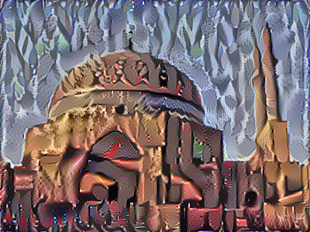
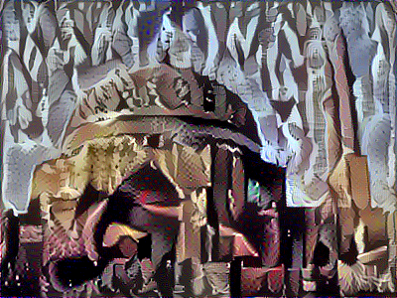
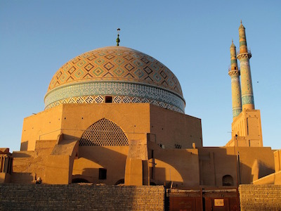
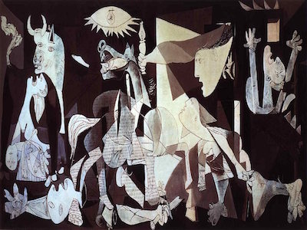
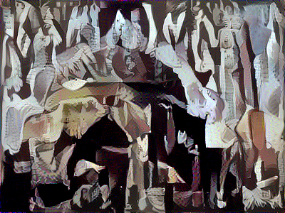
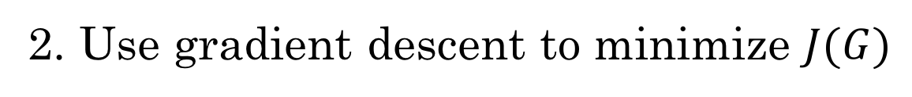
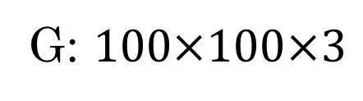
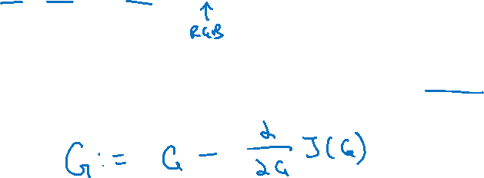
Lesson 14 - Find the generated image G
1. Initiate G randomly
G: $100×100×3$
2. Use gradient descent to minimize $J(G)$
[Gatys et al., 2015. A neural algorithm of artistic style]

Slide 14
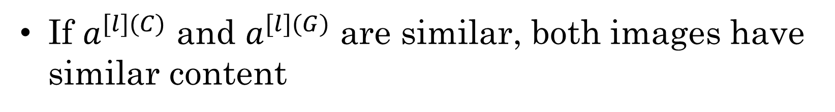
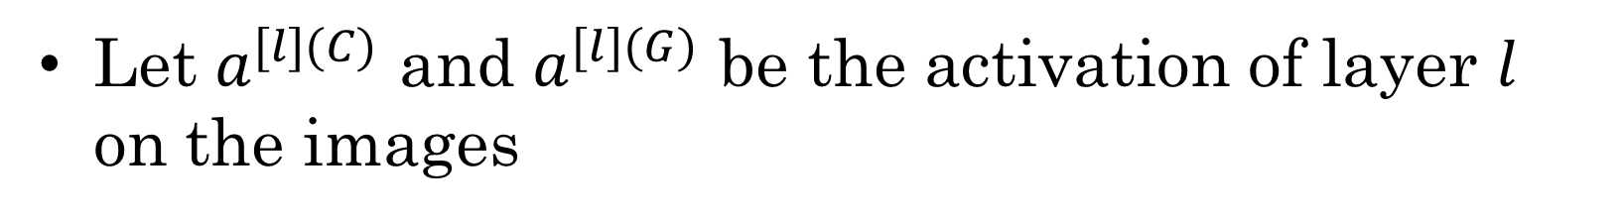
Lesson 14 - Content cost function
$$J\left(G\right)=α J_{content}\left(C,G\right)+β J_{style }(S,G)$$
Say you use hidden layer $l$ to compute content cost.
Use pre-trained ConvNet. (E.g., VGG network)
Let $a^{[l](C)}$ and $a^{[l](G)}$ be the activation of layer $l$ on the images
If $a^{[l](C)}$ and $a^{[l](G)}$ are similar, both images have similar content
[Gatys et al., 2015. A neural algorithm of artistic style]

Slide 15
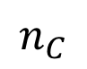
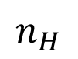
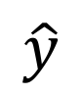
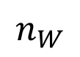
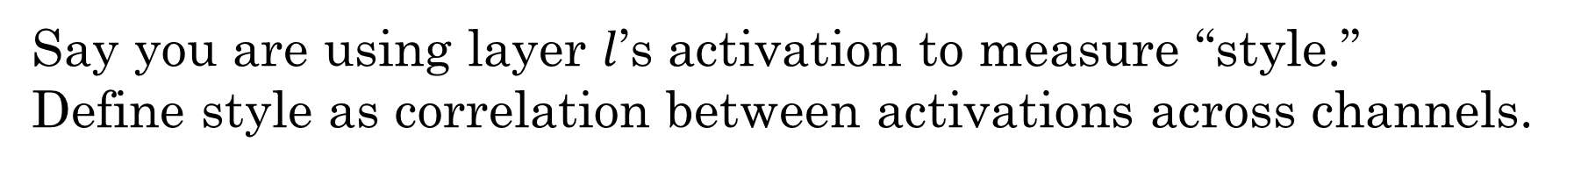
Lesson 14 - Meaning of the “style” of an image
$$\hat{y}$$
$$⋮$$
Say you are using layer $l$’s activation to measure “style.”
Define style as correlation between activations across channels.
How correlated are the activations across different channels?
$$n_{H}$$
$$n_{C}$$
$$n_{W}$$
[Gatys et al., 2015. A neural algorithm of artistic style]

Slide 16
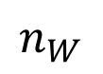
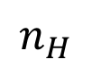
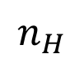
Lesson 14 - Intuition about style of an image
Style image
Generated Image
$$n_{H}$$
$$n_{H}$$
$$n_{C}$$
$$n_{C}$$
$$n_{W}$$
$$n_{W}$$
[Gatys et al., 2015. A neural algorithm of artistic style]
Notes:
Degree of correlation between channels as a measure of style

Slide 17
Lesson 14 - Exercise
Neural Style Transfer

Slide 18

Lesson 14 – 15 minute Break

Slide 19
Lesson 15 – Sequence Models
Not all data has a fixed length
Some data has a notion of time or position
We will need models that can handle these type of data

Slide 20
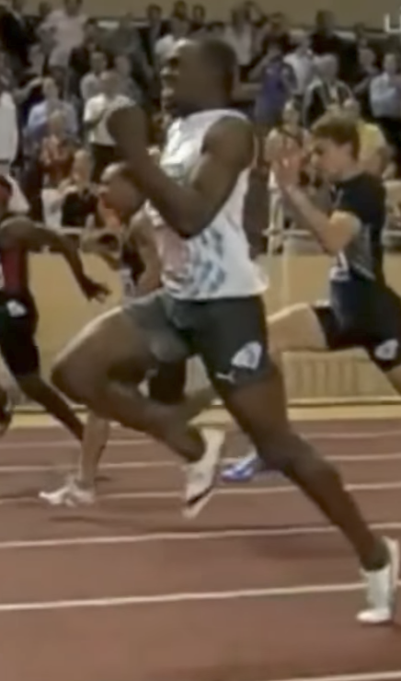
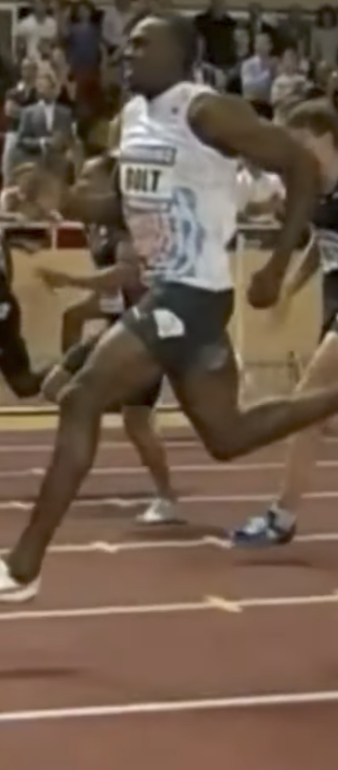
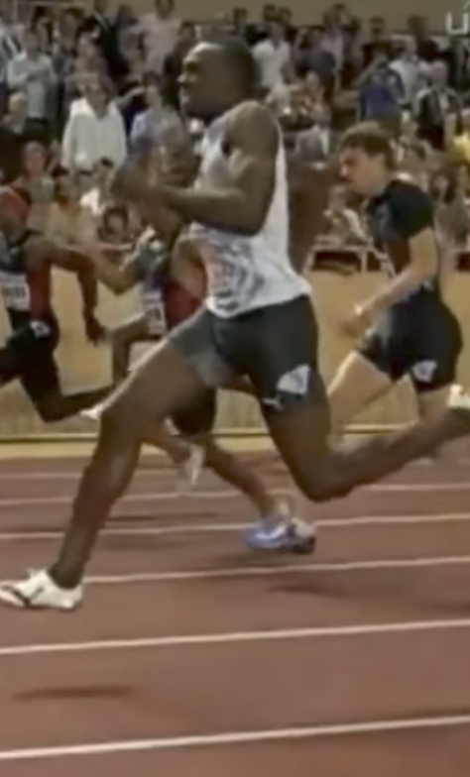
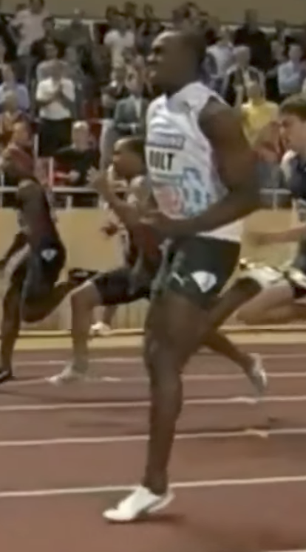
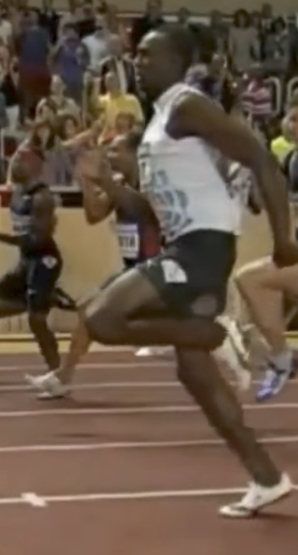

Lesson 15 - Examples of sequence data
“The quick brown fox jumped over the lazy dog.”
Speech recognition
Music generation
$$∅$$
Sentiment classification
“There is nothing to like in this movie.”
DNA sequence analysis
AGCCCCTGTGAGGAACTAG
AGCCCCTGTGAGGAACTAG
Machine translation
Voulez-vous chanter avec moi?
Do you want to sing with me?
Plasmid sequence AP4 Oligo
Video activity recognition
Running
Name entity recognition
Yesterday, Harry Potter met Hermione Granger.
Yesterday, Harry Potter met Hermione Granger.
Notes:
Explain why sequence data is different
Talk through each example and highlight where the input is a different length than the output

Slide 21
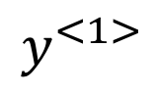
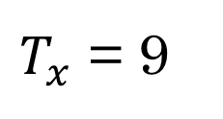
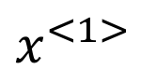
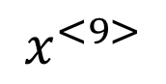
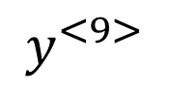
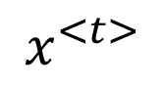
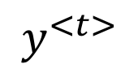
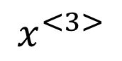
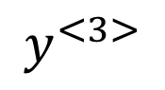
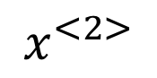
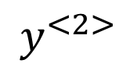
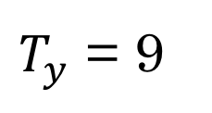
Lesson 15 - Motivating example
x:
Harry Potter and Hermione Granger invented a new spell.
$$x^{<1>}$$
$$x^{<2>}$$
$$x^{<3>}$$
………………
$$x^{<t>}$$
………………………………..
$$x^{<9>}$$
y:
1
1
0
1
1
0
0
0
0
$$y^{<1>}$$
$$y^{<2>}$$
$$y^{<3>}$$
………………
$$y^{<t>}$$
………………………………..
$$y^{<9>}$$
$T_{x}$ = 9
$T_{y}$ = 9
Notes:
NLP
Named entity recognition
Used by search engines to summarize news articles
Show how y relates to x
Tx = 9 – length of input
Ty = 9 0 length of output

Slide 22
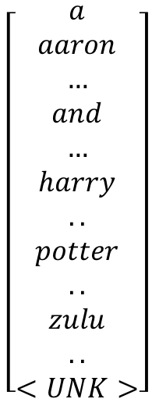
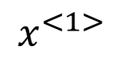







Lesson 15 - Representing words
x:
Harry Potter and Hermione Granger invented a new spell.
$$x^{<1>}$$
$$x^{<2>}$$
$$x^{<3>}$$
$$⋯$$
$$x^{<9>}$$
Vocabulary
$$\left[\begin{aligned}a \\ aaron \\ … \\ and \\ … \\ harry \\ .. \\ potter \\ .. \\ zulu \\ .. \\ <UNK>\end{aligned}\right]$$
1
$$\left[\begin{aligned}0 \\ 0 \\ … \\ 0 \\ 1 \\ 0 \\ … \\ … \\ … \\ 0\end{aligned}\right]$$
$$\left[\begin{aligned}0 \\ 0 \\ … \\ … \\ 0 \\ 1 \\ 0 \\ … \\ … \\ 0\end{aligned}\right]$$
$$\left[\begin{aligned}0 \\ … \\ 0 \\ 1 \\ 0 \\ … \\ … \\ … \\ … \\ 0\end{aligned}\right]$$
2
367
367
4075
10000
4075
6830
6830
9995
10000
ONE-HOT ENCODING
Notes:
How do you represent a word like Harry
First thing to do is come up with a vocabulary
Explain what a one-hot encoding would be

Slide 23










Lesson 15 - Why not a standard network?
$$x^{<1>}$$
$$y^{<1>}$$
$$x^{<2>}$$
$$y^{<2>}$$
$$⋮$$
$$⋮$$
$$⋮$$
$$⋮$$
$$x^{<T_{x}>}$$
$$y^{<T_{y}>}$$
Problems:
- Inputs, outputs can be different lengths in different examples.
- Doesn’t share features learned across different positions of text.

Slide 24
















Lecture 15 - Recurrent Neural Networks
$${\hat{y}}^{<1>}$$
$${\hat{y}}^{<2>}$$
$${\hat{y}}^{<3>}$$
$${\hat{y}}^{<T_{y}>}$$
$$a^{<1>}$$
$$a^{<2>}$$
$$a^{<T_{x}−1>}$$
$$a^{<0>}$$
$$⋯$$
$${\hat{y}}^{<t>}$$
$$x^{<1>}$$
$$x^{<2>}$$
$$x^{<3>}$$
$$x^{<T_{x}>}$$
$$a^{<t>}$$
He said, “Teddy Roosevelt was a great President.”
He said, “Teddy bears are on sale!”
$$x^{<t>}$$
Notes:
We need a model that can handle variable length inputs and outputs and a can take position into account
Only words encountered at t-1 can contribute to the output at t, it would be helpful to use words that come after a given word

Slide 25






Lecture 15 - Forward Propagation
$${\hat{y}}^{<1>}$$
$${\hat{y}}^{<2>}$$
$${\hat{y}}^{<3>}$$
$${\hat{y}}^{<T_{y}>}$$
$$a^{<1>}$$
$$a^{<2>}$$
$$a^{<T_{x}−1>}$$
$$a^{<0>}$$
$$⋯$$
$$x^{<1>}$$
$$x^{<2>}$$
$$x^{<3>}$$
$$x^{<T_{x}>}$$
$$a^{<t>}=g(W_{aa}a^{<t−1>}+W_{ax}x^{<t>}+b_{a})$$
$${\hat{y}}^{<t>}=g(W_{ya}a^{<t>}+b_{y})$$

Slide 26

Lecture 15 – Loss Function
$${\hat{y}}^{<1>}$$
$${\hat{y}}^{<2>}$$
$${\hat{y}}^{<3>}$$
$${\hat{y}}^{<T_{y}>}$$
$$a^{<1>}$$
$$a^{<2>}$$
$$a^{<T_{x}−1>}$$
$$a^{<0>}$$
$$⋯$$
$$x^{<1>}$$
$$x^{<2>}$$
$$x^{<3>}$$
$$x^{<T_{x}>}$$
$$ℒ^{<t>}\left({\hat{y}}^{<t>},y^{<t>}\right)=y^{<t>}log{\hat{y}}^{<t>}−(1−y^{<t>})log⁡(1−{\hat{y}}^{<t>})$$
$$ℒ\left(\hat{y},y \right)=\sum_{t=1}^{T_{y}}{ℒ^{<t>}\left({\hat{y}}^{<t>},y^{<t>}\right)}$$

Slide 27
Lesson 15 - Examples of sequence data
“The quick brown fox jumped over the lazy dog.”
Speech recognition
Music generation
$$∅$$
Sentiment classification
“There is nothing to like in this movie.”
DNA sequence analysis
AGCCCCTGTGAGGAACTAG
AGCCCCTGTGAGGAACTAG
Machine translation
Voulez-vous chanter avec moi?
Do you want to sing with me?
Plasmid sequence AP4 Oligo
Video activity recognition
Running
Name entity recognition
Yesterday, Harry Potter met Hermione Granger.
Yesterday, Harry Potter met Hermione Granger.

Slide 28


























Lesson 15 - Summary of RNN types
$${\hat{y}}^{<1>}$$
$${\hat{y}}^{<1>}$$
$${\hat{y}}^{<2>}$$
$${\hat{y}}^{<T_{y}>}$$
$${\hat{y}}^{ }$$
$$a^{<0>}$$
$$a^{<0>}$$
$$⋯$$
$$a^{<0>}$$
$$⋯$$
$$x^{<1>}$$
$$x$$
$$x^{<1>}$$
$$x^{<2>}$$
$$x^{<T_{x}>}$$
One to one
One to many
Many to one
$${\hat{y}}^{<1> }$$
$${\hat{y}}^{<2> }$$
$${{\hat{y}}^{<1>}}^{ }$$
$${{\hat{y}}^{<T_{y}>}}^{ }$$
$${\hat{y}}^{<T_{y}> }$$
$$a^{<0>}$$
$$⋯$$
$$⋯$$
$$⋯$$
$$a^{<0>}$$
$$⋯$$
$$x^{<1>}$$
$$x^{<T_{x}>}$$
$$x^{<1>}$$
$$x^{<2>}$$
$$x^{<T_{x}>}$$
Many to many
Many to many

Slide 29

Lesson 15 - What is language modelling?
Speech recognition
The apple and pair salad.
The apple and pear salad.
$P($The apple and pair salad$)=3.2 x {10}^{−13}$
$P($The apple and pear salad$)=5.7 x {10}^{−10}$
Notes:
A language model predicts the probability of a sequence of words

Slide 30









Lesson 15 – Building Language models with an RNN
Training set: large corpus of english text.
Cats average 15 hours of sleep a day. <EOS>
$$y^{<1>}$$
$$y^{<2>}$$
$$y^{<3>}$$
$$y^{<4>}$$
$$y^{<5>}$$
$$y^{<6>}$$
$$y^{<7>}$$
$$y^{<8>}$$
$$y^{<9>}$$
The Egyptian Mau is a bread of cat. <EOS>
<UNK>
Notes:
How do you build a language model

Slide 31
















Lesson 15 – RNN Model
$${\hat{y}}^{<1> }$$
$${\hat{y}}^{<2> }$$
$${\hat{y}}^{<3> }$$
$${\hat{y}}^{<9> }$$
$$a^{<0>}=\vec{0}$$
$$a^{<1>}$$
$$a^{<2>}$$
$$a^{<3>}$$
$$⋯$$
$$a^{<9>}$$
$$x^{<1>}=\vec{0}$$
$${x^{<2>}= y}^{<1>}$$
$${x^{<3>}=y}^{<2>}$$
$${x^{<9>}=y}^{<8>}$$
Cats
average
day
Cats average 15 hours of sleep a day. <EOS>
$$ℒ\left({\hat{y}}^{<t>},y^{<t>}\right)=−\sum_{i}{ }y_{i}^{<t>}{\log{\hat{y}}}_{i}^{<t>}$$
$$ℒ^{ }=\sum_{t}{ }ℒ^{<t>}\left({\hat{y}}^{<t>},y^{<t>}\right)$$

Slide 32





















Lesson 15 – Sampling from a RNN
$${\hat{y}}^{<1> }$$
$${\hat{y}}^{<2> }$$
$${\hat{y}}^{<3> }$$
$${\hat{y}}^{<9> }$$
Training
$$a^{<0>}=\vec{0}$$
$$a^{<1>}$$
$$a^{<2>}$$
$$a^{<3>}$$
$$⋯$$
$$a^{<9>}$$
$$x^{<1>}=\vec{0}$$
$${x^{<2>}= y}^{<1>}$$
$${x^{<3>}=y}^{<2>}$$
$${x^{<9>}=y}^{<8>}$$
$${\hat{y}}^{<1> }$$
$${\hat{y}}^{<2> }$$
$${\hat{y}}^{<3> }$$
$${\hat{y}}^{<9> }$$
Sampling
$$a^{<0>}=\vec{0}$$
$$a^{<1>}$$
$$a^{<2>}$$
$$a^{<3>}$$
$$⋯$$
$$a^{<9>}$$
$$x^{<1>}=\vec{0}$$
$${\hat{y}}^{<1> }$$
$${\hat{y}}^{<2> }$$
$${\hat{y}}^{<8> }$$

Slide 33














Lesson 15 - Character-level language model
Vocabulary = [a, aaron, …, zulu, <UNK>]
Vocabulary = [a, b, c, ….. , z, 0,1, ….9, A, B, …. ,Z]
$${\hat{y}}^{<1> }$$
$${\hat{y}}^{<2> }$$
$${\hat{y}}^{<3> }$$
$${\hat{y}}^{<T_{y}> }$$
$$a^{<0>}$$
$$a^{<1>}$$
$$a^{<2>}$$
$$a^{<3>}$$
$$⋯$$
$$a^{<T_{y}>}$$
$$x^{<1>}$$
$${\hat{y}}^{<1> }$$
$${\hat{y}}^{<2> }$$
$${\hat{y}}^{<T_{x}−1> }$$

Slide 34
Lesson 15 - Sequence generation
News
Shakespeare
President enrique peña nieto, announced sench’s sulk former coming football langston paring.
“I was not at all surprised,” said hich langston.
“Concussion epidemic”, to be examined.
The gray football the told some and this has on the uefa icon, should money as.
The mortal moon hath her eclipse in love.
And subject of this thou art another this fold.
When besser be my love to me see sabl’s.
For whose are ruse of mine eyes heaves.

Slide 35















Lesson 15 - Vanishing gradients with RNNs
The cat, which already ate ………………………, was full
The cats, which already ate …………………, were full
$${\hat{y}}^{<1> }$$
$${\hat{y}}^{<2> }$$
$${\hat{y}}^{<3> }$$
$${\hat{y}}^{<T_{y}> }$$
$$a^{<0>}$$
$$a^{<1>}$$
$$a^{<2>}$$
$$a^{<3>}$$
$$⋯$$
$$a^{<T_{y}>}$$
$$x^{<1>}$$
$$x^{<2>}$$
$$x^{<3>}$$
$$x^{<T_{x}>}$$
$$x^{ }$$
$$⋯$$
$${\hat{y}}^{ }$$
$$⋮$$
$$⋮$$
$$⋮$$
$$⋮$$
$$⋮$$
$$⋮$$
$$⋮$$
Exploding gradients.
Notes:
Languages can have long term dependencies
Basic RNN isn’t good a capturing long range dependencies
As networks get deeper we run into issues of vanishing and exploding gradients

Slide 36





Lesson 15 - RNN unit
$${\hat{y}}^{<t> }$$
softmax
tanh
$$a^{<t−1>}$$
$$a^{<t>}$$
$$a^{<t>}=g(W_{a}\left[a^{<t−1>}, x^{<t>}\right]+b_{a})$$
$$x^{<t>}$$
Notes:
The formula for computing the activation function of an RNN at time step t

Slide 37











































Lesson 15 - LSTM
$$y^{<t>}$$
$${\tilde{c}}^{<t>}=\tanh{(W_{c}\left[a^{<t−1>},x^{<t>}\right]+b_{c})}$$
softmax
$$a^{<t>}$$
$$Γ_{u}=σ{(W_{u}\left[ a^{<t−1>},x^{<t>}\right]+b_{u})}$$
-
-
$$c^{<t−1>}$$
$$c^{<t>}$$
-
*
$$⨁$$
-
$$Γ_{f}=σ{(W_{f}\left[ a^{<t−1>},x^{<t>}\right]+b_{f})}$$
$$c^{<t>}$$
*
tanh
$$Γ_{o}=σ{(W_{o}\left[ a^{<t−1>},x^{<t>}\right]+b_{o})}$$
$$a^{<t−1>}$$
*
$$a^{<t>}$$
$$f^{<t>}$$
$$i^{<t>}$$
$${\tilde{c}}^{<t>}$$
$$o^{<t>}$$
$$a^{<t>}$$
$$c^{<t>}={Γ_{u}∗{\tilde{c}}^{<t>}+Γ_{f}∗c^{<t−1>}}$$
forget gate
update gate
tanh
output gate
$$a^{<t>}=Γ_{o}∗c^{<t>}$$
$$x^{<t>}$$
$$y^{<1>}$$
$$y^{<2>}$$
$$y^{<3>}$$
softmax
softmax
softmax
$$a^{<1>}$$
$$a^{<2>}$$
-
$$c^{<2>}$$
$$a^{<3>}$$
-
-
$$c^{<1>}$$
-
-
$$c^{<3>}$$
-
-
-
-
-
-
$$c^{<0>}$$
*
$$⨁$$
-
$$c^{<1>}$$
*
$$⨁$$
$$c^{<2>}$$
*
$$⨁$$
$$a^{<0>}$$
$$a^{<1>}$$
$$a^{<2>}$$
$$a^{<2>}$$
$$a^{<1>}$$
$$a^{<3>}$$
$$x^{<1>}$$
$$x^{<2>}$$
$$x^{<3>}$$
Notes:
Can learn long range sequences

Slide 38




















Lesson 15 - Getting information from the future
He said, “Teddy bears are on sale!”
He said, “Teddy Roosevelt was a great President!”
$${\hat{y}}^{<1> }$$
$${\hat{y}}^{<2> }$$
$${\hat{y}}^{<3> }$$
$${\hat{y}}^{<4> }$$
$${\hat{y}}^{<5> }$$
$${\hat{y}}^{<6> }$$
$${\hat{y}}^{<7> }$$
$$a^{<0>}$$
$$a^{<1>}$$
$$a^{<2>}$$
$$a^{<3>}$$
$$a^{<4>}$$
$$a^{<5>}$$
$$a^{<6>}$$
$$a^{<7>}$$
$$x^{<1>}$$
$$x^{<2>}$$
$$x^{<3>}$$
$$x^{<4>}$$
$$x^{<5>}$$
$$x^{<6>}$$
$$x^{<7>}$$
He said, “Teddy bears are on sale!”

Slide 39













Lesson 15 – Bidirectional RNN (BRNN)
$${\hat{y}}^{<1> }$$
$${\hat{y}}^{<2> }$$
$${\hat{y}}^{<3> }$$
$${\hat{y}}^{<4> }$$
$$a^{<0>}$$
$$a^{<1>}$$
$$a^{<2>}$$
$$a^{<3>}$$
$$a^{<4>}$$
$${a′}^{<1>}$$
$${a′}^{<2>}$$
$${a′}^{<3>}$$
$${a′}^{<4>}$$
$$x^{<1>}$$
$$x^{<2>}$$
$$x^{<3>}$$
$$x^{<4>}$$

Slide 40






















Lesson 15 - Deep RNN example
$$y^{<1>}$$
$$y^{<2>}$$
$$y^{<3>}$$
$$y^{<4>}$$
$$a^{[3]<0>}$$
$$a^{[3]<1>}$$
$$a^{[3]<2>}$$
$$a^{[3]<3>}$$
$$a^{[3]<4>}$$
$$a^{[2]<0>}$$
$$a^{[2]<1>}$$
$$a^{[2]<2>}$$
$$a^{[2]<3>}$$
$$a^{[2]<4>}$$
$$a^{[1]<0>}$$
$$a^{[1]<1>}$$
$$a^{[1]<2>}$$
$$a^{[1]<3>}$$
$$a^{[1]<4>}$$
$$x^{<1>}$$
$$x^{<2>}$$
$$x^{<3>}$$
$$x^{<4>}$$

Slide 41






Lesson 15 - Word representation
V = [a, aaron, …, zulu, <UNK>]
1-hot representation
Man
(5391)
Woman
(9853)
King
(4914)
Queen
(7157)
Apple
(456)
Orange
(6257)
I want a glass of orange ______.
I want a glass of apple______.
$$\left[\begin{aligned}\begin{matrix}0 \\ 0 \\ 0\end{matrix} \\ 0 \\ ⋮ \\ 1 \\ ⋮ \\ 0 \\ 0\end{aligned}\right]$$
$$\left[\begin{aligned}\begin{matrix}0 \\ 0 \\ 0\end{matrix} \\ 0 \\ 0 \\ ⋮ \\ 1 \\ ⋮ \\ 0\end{aligned}\right]$$
$$\left[\begin{aligned}\begin{matrix}0 \\ 0 \\ 0\end{matrix} \\ ⋮ \\ 1 \\ ⋮ \\ 0 \\ 0 \\ 0\end{aligned}\right]$$
$$\left[\begin{aligned}\begin{matrix}0 \\ 0 \\ 0\end{matrix} \\ 0 \\ 0 \\ ⋮ \\ 1 \\ ⋮ \\ 0\end{aligned}\right]$$
$$\left[\begin{aligned}\begin{matrix}0 \\ ⋮ \\ 1\end{matrix} \\ ⋮ \\ 0 \\ 0 \\ 0 \\ 0 \\ 0\end{aligned}\right]$$
$$\left[\begin{aligned}\begin{matrix}0 \\ 0 \\ 0\end{matrix} \\ 0 \\ 0 \\ ⋮ \\ 1 \\ ⋮ \\ 0\end{aligned}\right]$$
Notes:
1-hot representations don’t capture relationships between words

Slide 42


Lesson 15 - Featurized representation: embedding
Man
(5391)
Woman
(9853)
King
(4914)
Queen
(7157)
Apple
(456)
Orange
(6257)
-1
1
-0.95
$$0.97$$
0.00
0.01
Gender
Royal
0.01
0.02
0.93
$$0.95$$
-0.01
0.00
Age
0.03
0.02
0.7
0.69
0.03
-0.02
Food
0.04
0.01
0.02
0.01
0.95
0.97
I want a glass of orange ______.
I want a glass of apple______.

Slide 43
Lesson 15 - Visualizing word embeddings
man
woman
dog
king
cat
queen
fish
apple
grape
three
four
one
orange
two
[van der Maaten and Hinton., 2008. Visualizing data using t-SNE]

Slide 44




Lesson 15 - Named entity recognition example
$$1$$
$$1$$
$$0$$
$$0$$
$$0$$
$$0$$
Sally Johnson is an orange farmer
Robert Lin is an apple farmer
Notes:
Since orange and apple are similar we can predict that Robert Lin is a person

Slide 45
Lesson 15 - Transfer learning and word embeddings
Learn word embeddings from large text corpus. (1-100B words)
(Or download pre-trained embedding online.)
2. Transfer embedding to new task with smaller training set.
(say, 100k words)
3. Optional: Continue to finetune the word embeddings with new
data.

Slide 46





Lesson 15 - Analogies
Man
(5391)
Woman
(9853)
King
(4914)
Queen
(7157)
Apple
(456)
Orange
(6257)
Gender
$$−1$$
1
-0.95
$$0.97$$
0.00
0.01
Royal
$$0.01$$
0.02
0.93
$$0.95$$
-0.01
0.00
Age
0.03
0.02
0.70
0.69
0.03
-0.02
Food
0.09
0.01
0.02
0.01
0.95
0.97
Man -> Woman as King -> ?
$$e_{man}−e_{woman}≈e_{king}−e_{queen}$$
[Mikolov et. al., 2013, Linguistic regularities in continuous space word representations]

Slide 47

Lesson 15 - Analogies using word vectors
man
woman
dog
king
cat
woman
queen
fish
queen
three
four
apple
grape
one
two
orange
man
$$e_{man}−e_{woman}≈e_{king}−e_{?}$$
king
$${\arg{\max{sim\left(e_{?},{e_{king}−e}_{man}+e_{woman}\right)}}}_{}$$

Slide 48

Lesson 15 – Skip gram

Slide 49

Lesson 15 – Skip gram

Slide 50

Lesson 15 – Skip gram

Slide 51
Lesson 15 - Exercise
Working with embeddings

Slide 52
Lesson 15 – 15 minute Break

Slide 53


Lesson 16 - Sentiment classification problem
$$x$$
$$y$$
The dessert is excellent.
Service was quite slow.
Good for a quick meal, but nothing special.
Completely lacking in good taste, good service, and good ambience.

Slide 54

















Lesson 15 - RNN for sentiment classification
$$\hat{y}$$
softmax
$$a^{<0>}$$
$$a^{<1>}$$
$$a^{<2>}$$
$$a^{<3>}$$
$$a^{<4>}$$
$$⋯$$
$$a^{<10>}$$
$$e_{1852}$$
$$e_{4966}$$
$$e_{4427}$$
$$e_{3882}$$
$$e_{330}$$
$$E$$
$$E$$
$$E$$
$$E$$
$$E$$
Completely lacking in good …. ambience

Slide 55
Lesson 16 - Exercise
Sentiment analysis

Slide 56
Lesson 16 – 15 minute Break

Slide 57
Closing remarks
NLP Example
https://www.youtube.com/watch?v=bd1mEm2Fy08
Resources
https://www.coursera.org/specializations/deep-learning
http://course.fast.ai/
Happy to help your group kick-start Deep Learning efforts

